Slide 1

Alejandro Rodriguez
Department of Finance
University of Central Florida
https://github.com/arodriguezb52
Notes:
1

Slide 2
Outline
Artificial Intelligence
Agentic AI
Introduction of LangChain
Introduction to LangGraph
Highlight improvements and changes from Chain to Graph
RAG and its functionality
Improvements made on RAG to get to GraphRag
GraphRag uses and architecture
Breakdown of existing pipeline

Slide 3
Origins of AI
Contrary to popular belief the field of artificial intelligence is not new. The origins of artificial intelligence date all the way to the 40s.
Year | Core Idea | Notable Names
1956 | Darmouth Workshop – formally coined the term Artificial Intelligence. | John McCarthy, Marvin Minsky, Claude Shannon, Allen Newell & Herbert Simon
2012 | AlexNet wins ImageNet, sparking the deep learning revolution, proving that neural networks + massive data + GPU outperformed every existing method. | Alex Krizhevsky, Ilya Sutskever, Geoffrey Hinton (Grandfather of AI)
2017 | Transformer architecture is developed. This is the backbone of modern large language models. | Ashish Vaswani, Niki Parmar, et al.
Notes:
In the Darmouth Workshop, participants presented early programs and debated how to mechanize reasoning, learning, language and creativity. In a sense uniting the research community to accomplish one goal. Prior, people referred to artificial intelligence as “machine thinking, automata studies, cybernetics”.
“The goal of AI is not to replace people; it’s to empower them to do what they do best.”

Slide 4
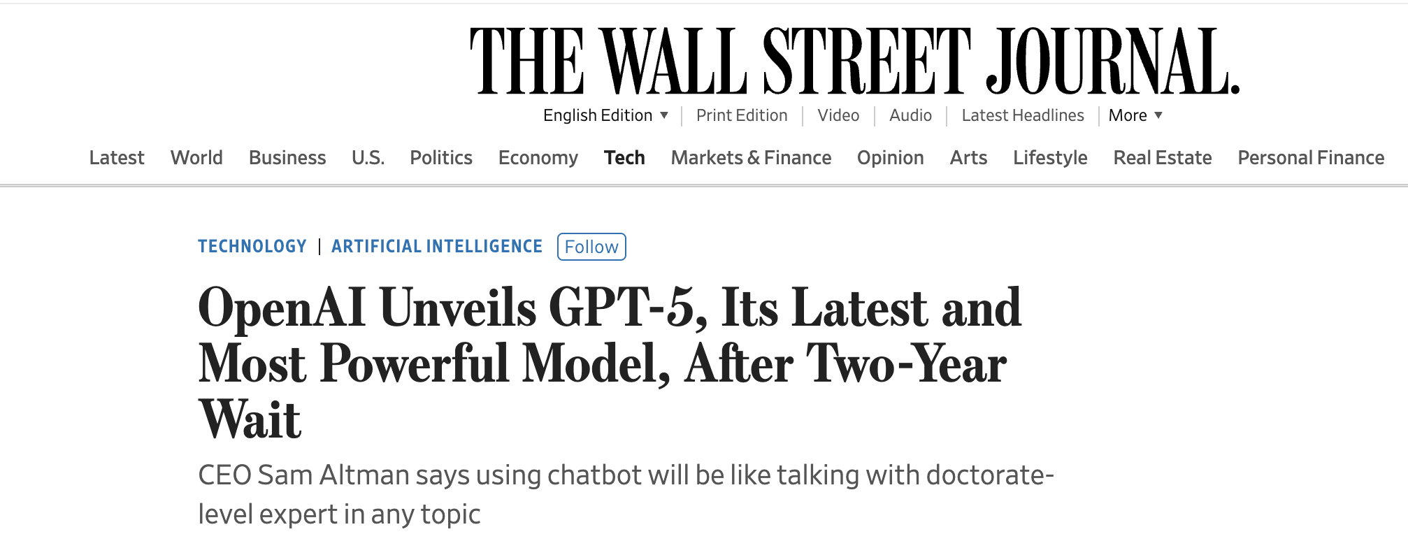
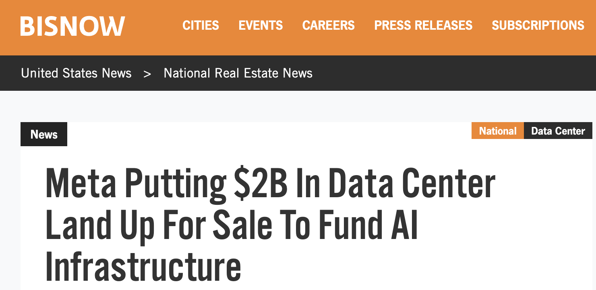
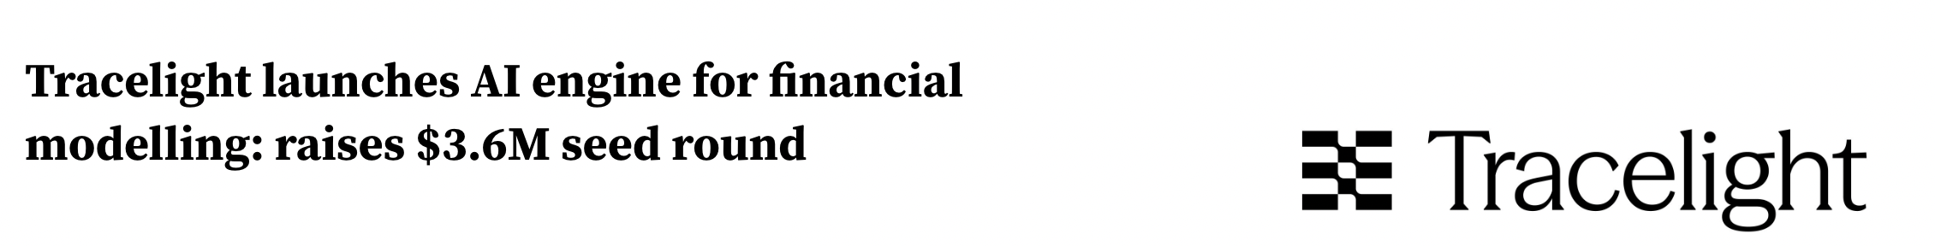
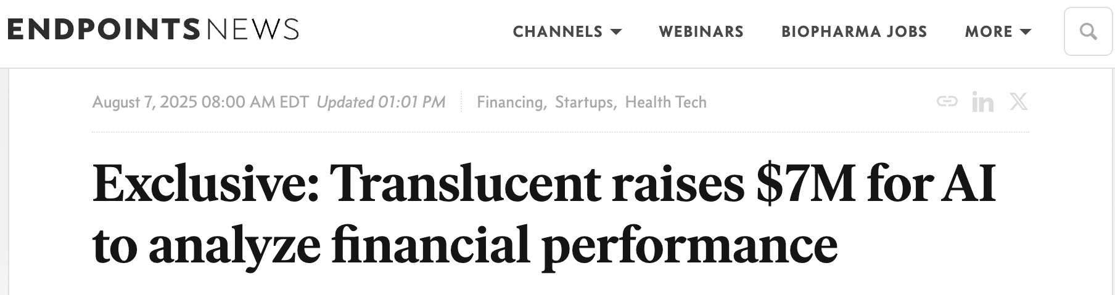
AI in 2025
Notes:
AI is the hot topic its everywhere in the news. Companies have caught on to the potential upside that AI has in store. They have realized that its not going anywhere and if anything they need to keep investing on it to enhance their workflows.
2025 marks the switch from AI being used just for chatbots but rather to agents that are capable of executing tasks.

Slide 5
What is Agentic AI?
Agentic AI is a way of using large-language models so they can do more than give a single answer.
They can figure out a plan, choose actions, and carry that plan out—all while you keep them on a leash.
Acts on a goal: Give the agent one broad instruction and it breaks the job into smaller steps by itself.
Grabs the right “helper apps”: It can call a web search, a database query, a calculator, or any other tool we have given.
Learns as it goes: After each step it checks the result, tweaks the plan, and tries again if needed.
Stays under control: You can put in checkpoints or safety rules so a human approves anything risky.
Notes:
Prior to this we have been using LLMs passively. What does that mean? We ask it questions and we get an answer.
I want you to think of a GPS: it chooses a route, re-routes when there’s traffic, and asks you to confirm tool roads. That’s autonomy, tool use, memory, and oversight – what I just described is Agentic AI.

Slide 6
Agentic AI Toolbox
We as users, get to decide which tools are available for use for our agent.
Some of the most commons tools are the following:
Web Search: it enables the agent to look up current facts.
GraphRAG query: gives access to a knowledge graph to retrieve information.
Calculator/ code runner: perform mathematical operations or run code snippets.
Email / Slack API: send notifications or ask a human for feedback or permission.
Memory store: it's how our agents keep notes of what its perceiving.
Notes:
For this analogy I want you to think of our agent being a child.
I want you to picture a child’s tablet with only approved apps. The kid can pick any app that helps him with solve his problem but can’t install new ones. We as the caregiver decide what’s on that tablet which keeps is safe.

Slide 7
Agentic AI Uses
So how can we use Agentic AI? How can companies benefit from this?
A common pain point that every company is having is the duplication of customers, many companies have multiple customers holding space in their databases. This issue is known as entity resolution.
How are they addressing this right now? Manually
What are some other uses?
Customer support (ChatBots for FAQs)
Data aggregation
Report generation
Automatic email responses
Notes:
We were approached by a credit company to help them with fraud detection. Fraud detection for a credit company has many faces and they all collapse to an entity resolution problem.
Prior to working on this entity resolution pipeline, I was working on a personal project that had agents pulling information from multiple sources and giving me a recommendation based on examples I gave it, so it had an idea of what my risk tolerance was or what a good deal for me was.

Slide 8

LangChain
LangChain is an open-source software framework designed to simplify the development of applications powered by large language models (LLM)
At its core, LangChain structures LLM logic into chains- which are ordered sequences of links, where each link performs a discrete action and passes its output to the next step
Formatting an input
Querying an LLM
Retrieving Data
LangChain represents one of the earliest and most widely accepted frameworks enabling LLM-powered agentic behavior
Notes:
So, what is powering our agents? How are we supposed to give it that set of instructions that it needs to follow to complete our task?
This is where LangChain comes in. LangChain was the first Swiss-army knife: it glued prompts, embeddings, tools and memory into repeatable ‘chains’.
As workflows grew and tasks became more complex, loops, human checkpoint, multiple agents were needed. The linearity that LangChain offered was not enough.
LangChain marked a critical steppingstone on the path of Agentic AI.

Slide 9
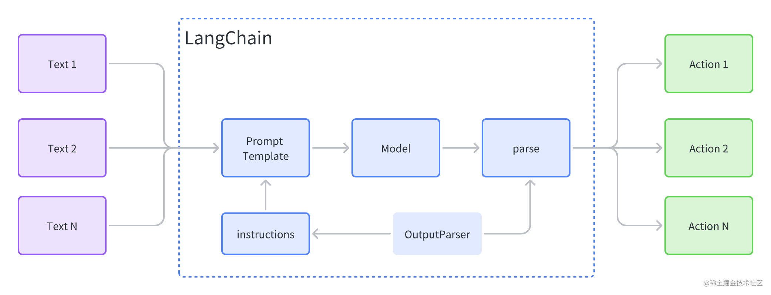
LangChain
Source: Juehin.cn, Chinese tech-based blog
https://juejin.cn/post/7438912418435072051?utm
Notes:
I want you to see the purple boxes on the left, this could be a customer email, a knowledge base, a chunk of text, etc, any docs needed for the agent to perform its task. From there we move on the prompt template where we create a fill-in-the-blank sheet with some instructions for our agent, for example ‘read the email and draft a short reply’.
That prompt then gets fed to the model whose is in charge of piecing the information that it received from the template to formulate a response. The raw model output get cleaned by an output parser so its machine friendly. Then we get an action out of that output, for example ‘send reply’, ‘archive’ or ‘tag urgent’.
As you can see everything is linear there is no forks or loops in the task. This is the major pain point that LangGraph solves which is the next iteration of LangChain.

Slide 10

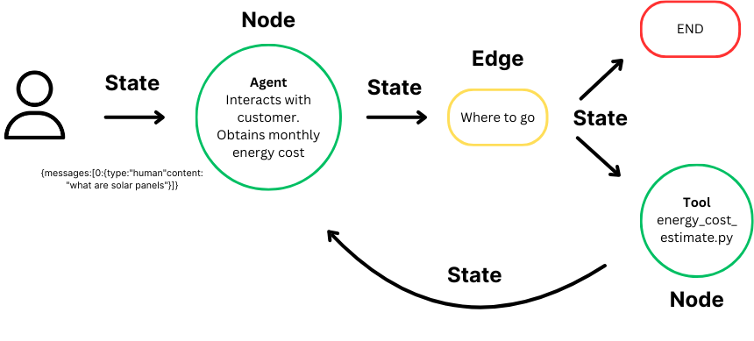
Introduction to LangGraph
LangGraph was born out of the LangChain project in late 2023.
The LangChain team realized the real-world LLM applications need more than just a linear prompt chain
They needed:
Stateful cyclic workflows, not just-one off calls
Fine-grained control over which “agent” or prompt runs
Built-in support for human overrides and feedback loops
A unified programming model to perform multi-agent processes
Notes:
Think of each node in the LangGraph as a runner on a relay team and ERState as the baton they carry. At every handoff, the states accumulates more information and the order in which this happens is shown by the flow of the LangGraph.

Slide 11
Improvements from LangChain to LangGraph
LangGraph replaced the DAG (directed acrylic graphs) model that LangChain had with a graph of nodes and edges. This enabled a cyclical workflow where loops are easily implemented
Centralized State Object: In LangChain we had an output being moved from link to link, LangGraph maintains a single mutable state that gets updated by each node
This provides the user with observability and prompt tweaking
Explicit Edges and Entry Points: With LangGraph we can add normal edges A -->B as well as conditional edges
A conditional edge: “If LLM says continue, loop back, otherwise end”.
Multi-agent orchestration: specialized agents collaborate via that shared state
Notes:
DAG is a strict, fixed sequence of steps, once the process begins you follow that path linearly. Looping is not a thing
Observability means that we can see how the state is being mutated as it moves along the graph making it easy for us to detect if anything is not working as intended. We can analyze how the state is being affected in each decision point.
Because observability is now possible prompt tweaking becomes more efficient and easier to enhance for desired results.

Slide 12
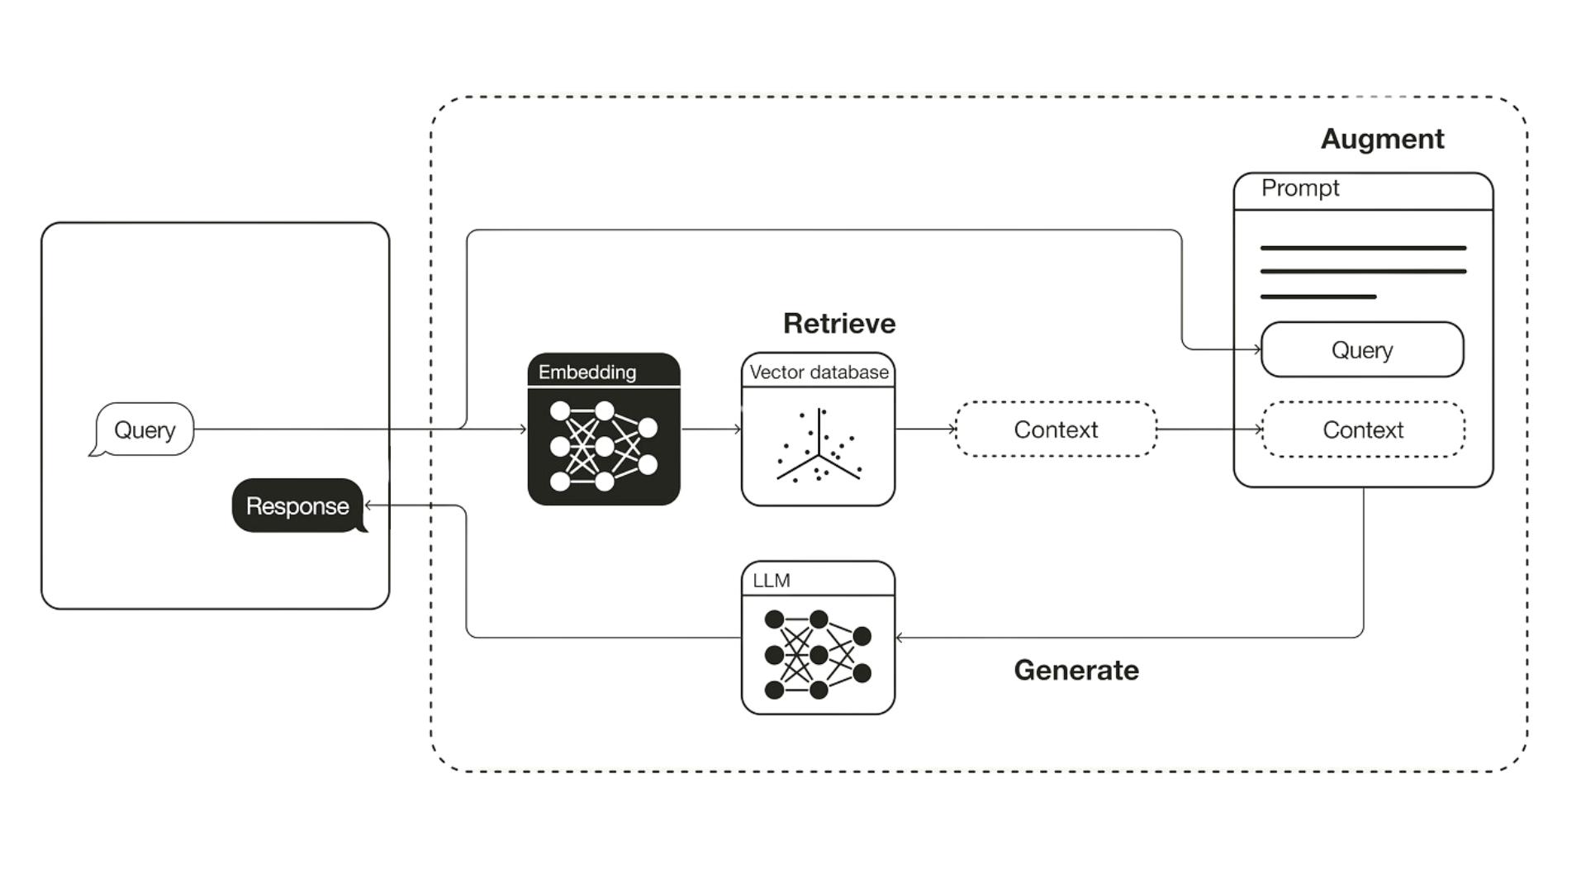
From RAG to GraphRAG
Retrieval Augmented Generation is the process that helps LLMs understand the context by integrating internal and external data sources
How does this happen:
Indexing: We embed documents into a vector store
Retrieving: Embed the query and run a similarity search
Augment: Attach top-k snippets from the similarity search
Generate: LLM reads prompt, and produces an answer for the user
Notes:
Where does regular RAG suffer? When we have a query that requires multi-hop or path seeking question, for example: Which suppliers of Tesla also supply Ford? In normal RAG text chunks arrive as independent blobs which gets rid of any structure that once linked them. Essentially shredding a map into confetti. The question of which suppliers of Tesla also supplies Ford requires our retrieval to keep its structure because we would be looking for a relationship between two entities. With regular RAG the top chunks would rarely put the relationship within the same chunk which makes our agent bridge that gap by guessing which often leads to hallucinations.

Slide 13
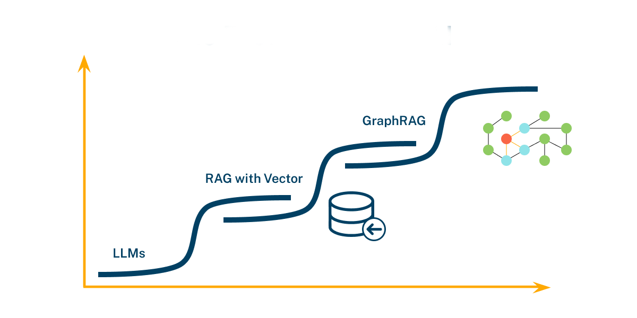
GraphRag
Graph Rag was developed late 2023 as an enhancement to the pre-existing RAG
Leverages a knowledge base to organize information, enabling structured retrieval and multi-hop reasoning for question answering
How does it work? Two main components:
The usage of LLMs to extract entities and relationships from unstructured data into a graph structure
RAG, this component is enriched by mapping out how said concepts are connected which helps LLMs handle complex queries and diverse data formats
Notes:
Graph RAG is the newest method of Retrieval Augmented Generation that stores facts as a graph (nodes and edges) instead of plain text chunks.

Slide 14
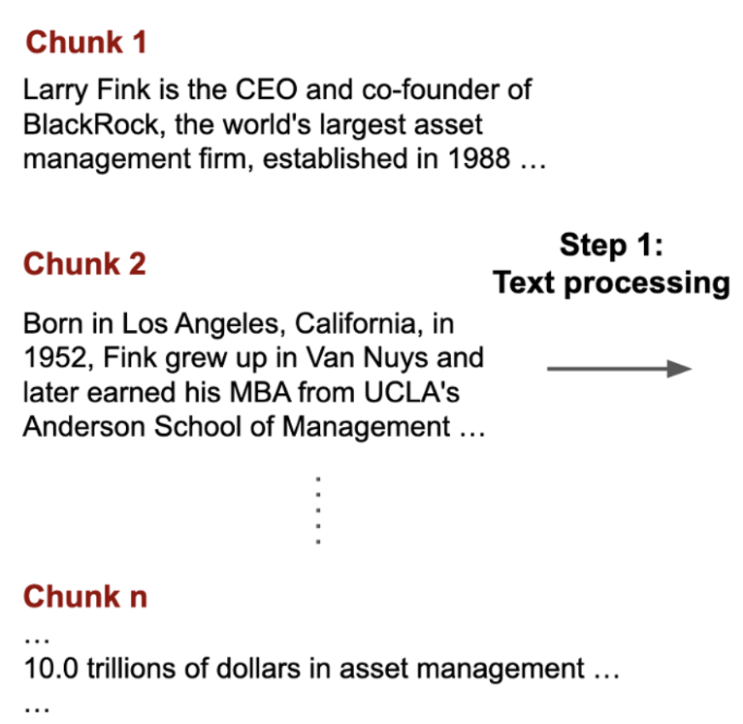
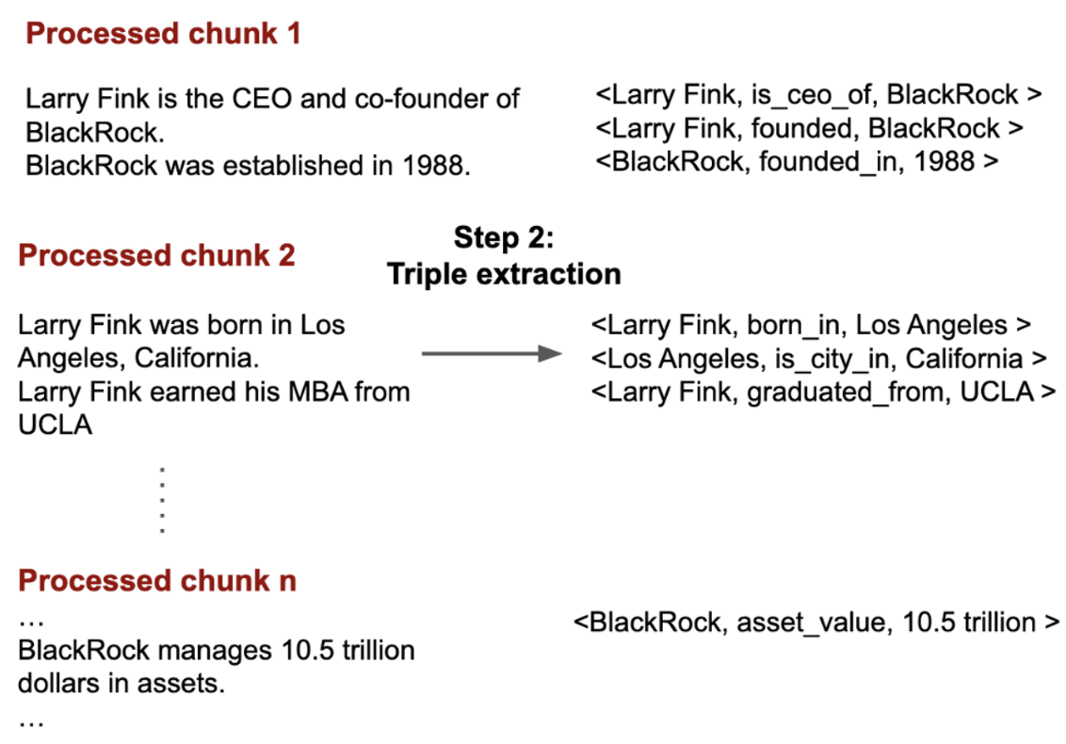
Triplet Extraction
Source: Graph Retrieval Augmented Generation, Glenn Matlin
Notes:
This process is known as triplet extraction. The main idea is that we are turning paragraphs into tiny ‘who-did-what’ facts that the graph can understand.
In step 1 we are breaking the chunks into short, single idea sentences.
On Step 2 we are extracting three parts of our simple sentences which are a subject, relation and object.
This process is very useful because once the triples are in a graph, information retrieval becomes path-finding, not paragraph hunting which in turns gets us a more lightweight and more reliable knowledge base which in turn reduces hallucinations.

Slide 15
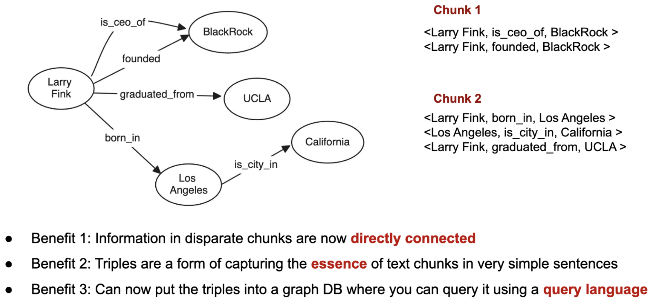
How GraphRag database is created
Source: Graph Retrieval Augmented Generation, Glenn Matlin
Notes:
So, this is how the simplified chunks would look in our database. So the benefits of using are the following…
Similarly to SQL where it has its own query language to pull and showcase data in a very organized and clean way, graphRAG has those same capabilities.

Slide 16
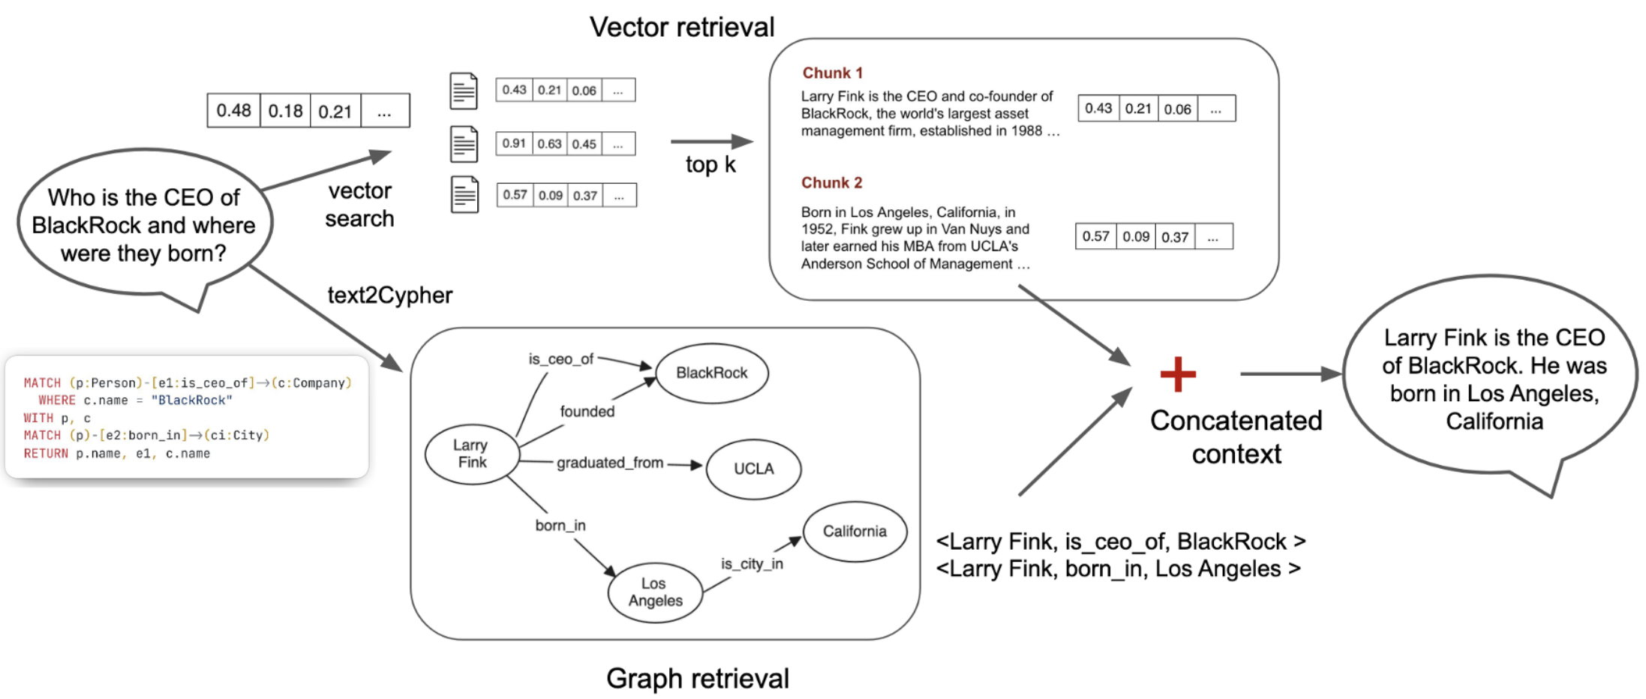
GraphRag in action
Source: Graph Retrieval Augmented Generation, Glenn Matlin
Notes:
This picture shows what our agent would be receiving. As you can see we are still using a vector retrieval and still doing a top k search like vanilla RAG.
But now, we are attaching a piece of our graph to enrich the context window for our agent. As you can see the graph is able to keep a relationships between facts even though said facts are not pertaining to the same chunk.
If we just depended on RAG our agent could hallucinate and make up facts since the top k are arriving in blobs and not keeping their relationship.

Slide 17
GraphRag Architecture
Knowledge Graph: This is where we are storing our data, usually we use a Neo4j.
A retriever tool (Cypher): This is how GraphRag retrieves information from the graph, we are giving it parameters that we want to retrieve.
Formatter: We need to be able to transform our node information and relationships into something that our LLM can read.
Node -> JSON or text
LLM or Agent: This is the the brains of our system. This is the piece that will synthesize the information formatted retrievals and answer queries.
Notes:
Neo4j is a native graph database—and a graph data platform around it.
It stores data as nodes/relationships with properties, queries it with Cypher, and can run self-hosted or as the managed Neo4j Aura cloud.
Knowledge Graph – This is where we are storing our data, usually we use a Neo4j. It makes sure that our data is structured & linked
Graph Retriever (Cypher) –I would like to highlight that Cypher enables multi-hop, attribute-filtered retrieval
Formatter / Context Builder – We need to be able to transform our node information and relationships into something that our LLM can read. Node -> JSON or text
LLM Agent – This is the the brains of our system. This is the piece that will synthesize the information formatted retrievals and answer queries. Reasoning Engine

Slide 18
START
Load Data & Light Pre-process
Creation and Connection to database (Neo4j)
Data Ingestion for Graph KB
Creation of Helper Rows
Setting Retrieval capabilities
Learn behavior from unsure cases
Agent A: Categorical
Agent B: Probability
END
Exports decisions and records to a DB
Ask user to help classify the unsure cases
Decision counter and storing
Manager:
Gives final decision
(match/unsure/no match
Notes:
This is the workflow of the pipeline that has been created. We will go in detail for every step but before I want to briefly show the workflow.
Agent A is a categorical agent that will give us a YES, NO, UNSURE
Agent B is our probabilistic agent that would assign a probability of 0 and 1
Our last agent who is our manager is in charge of synthesizing the output of both our agents and give us an decision of a match, unsure or no match
When our agents are unsure of how to classify the records, it will put it in the bucket of unsure cases. Those unsure cases then will get prompted to a human to help our agents learn and pick up more signals to better classify for the next iterations.

Slide 19
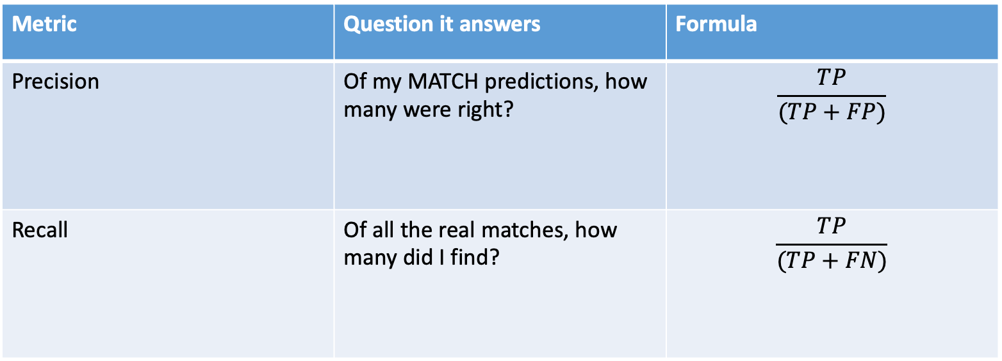
Dataset and Metrics
The dataset that we are testing on is the Abt-Buy a very common benchmark for entity resolution problem.
Values in this dataset are rather textual and describe various product features
The efficiency of our pipeline will be measured by the following metrics:
Metric | Question it answers | Formula
Precision | Of my MATCH predictions, how many were right? | $$\frac{TP}{(TP+FP)}$$
Recall | Of all the real matches, how many did I find? | $$\frac{TP}{(TP+FN)}$$
Notes:
Because we have no access to your data we opted to test on the Abt-Buy dataset which is a very common benchmark for entity resolution.
Attributes that we will be using are title and price

Slide 20
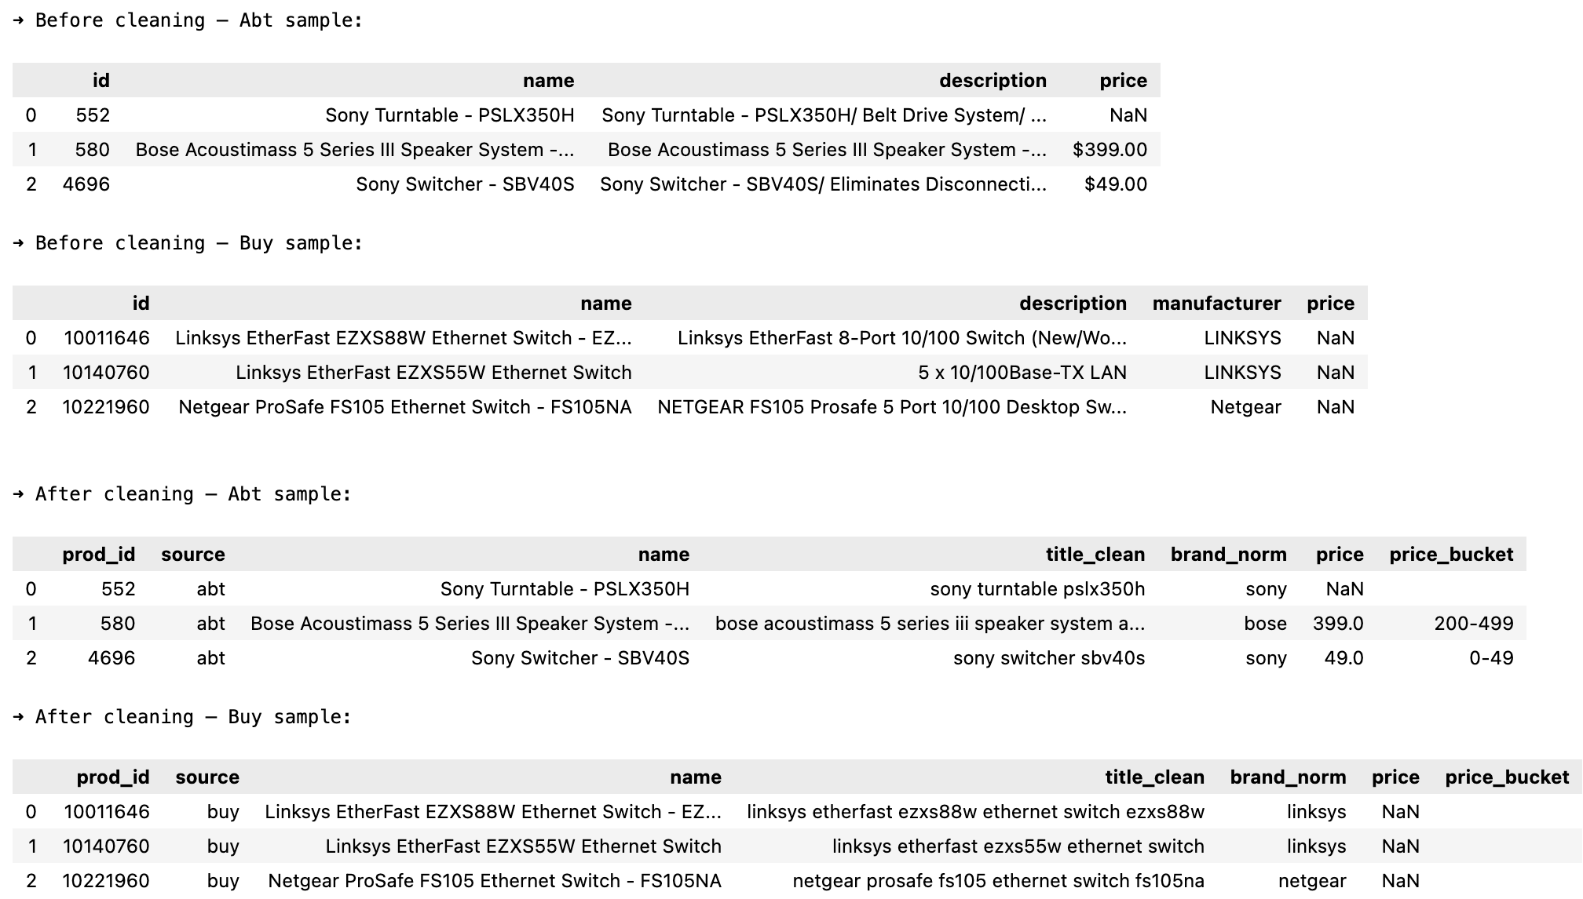
Code Explanation: Loading and Preprocessing
In this step, we are cleaning the name of the products as well as extracting its brand from their name
Notes:
I want you to look at the the after-cleaning sample where the title is cleaned, there is no capital letters and we get rid of special characters, we are also doing this with the brand names.
Essentially its in this step where we normalize our data to be uniform which will help when building our knowledge base.

Slide 21
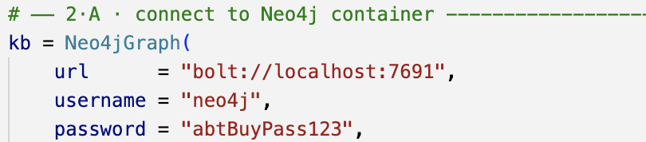
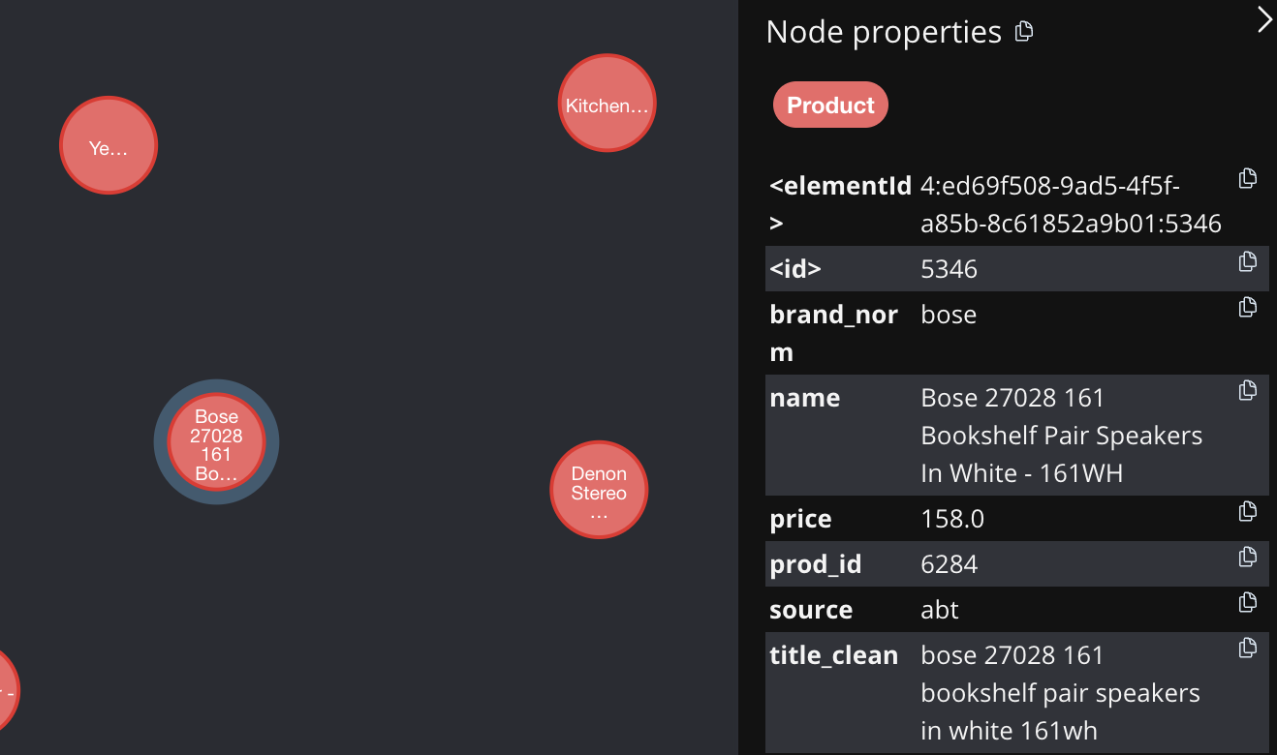
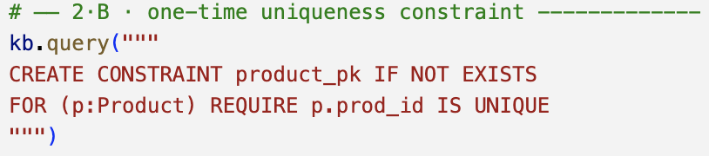
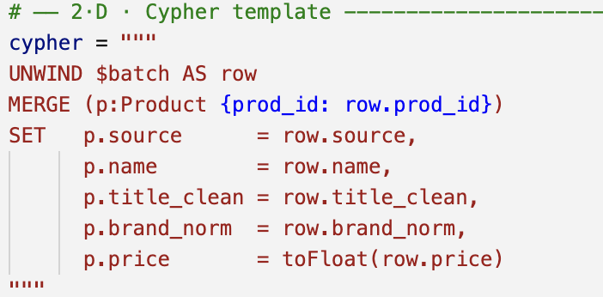
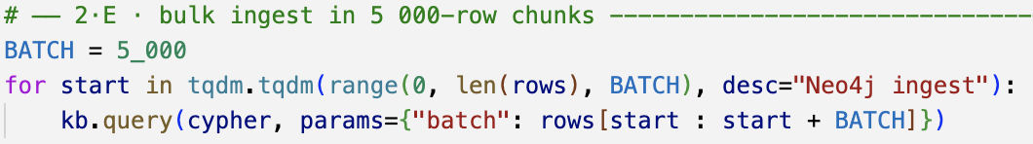
Code Explanation: Connection/Creation of DB and Ingestion
Notes:
One time uniqueness constraint ensures that when we try to ingest the same data with the same properties there won’t be a creation of a new node, instead merge it with the pre-existing node.
Cypher template is the Neo4j’s language in which we tell it how we want our data to be organized. In this case we want the product to have the properties mentioned.
In Cypher, like the English language, nouns are nodes (aka, entities) in a graph, while verbs are the relationships connecting entities.

Slide 22
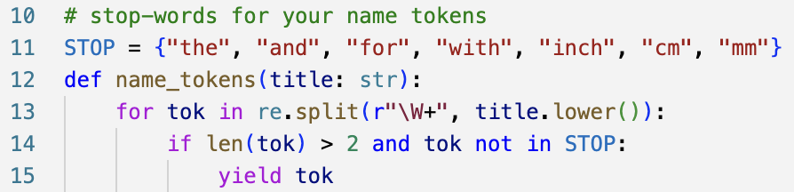
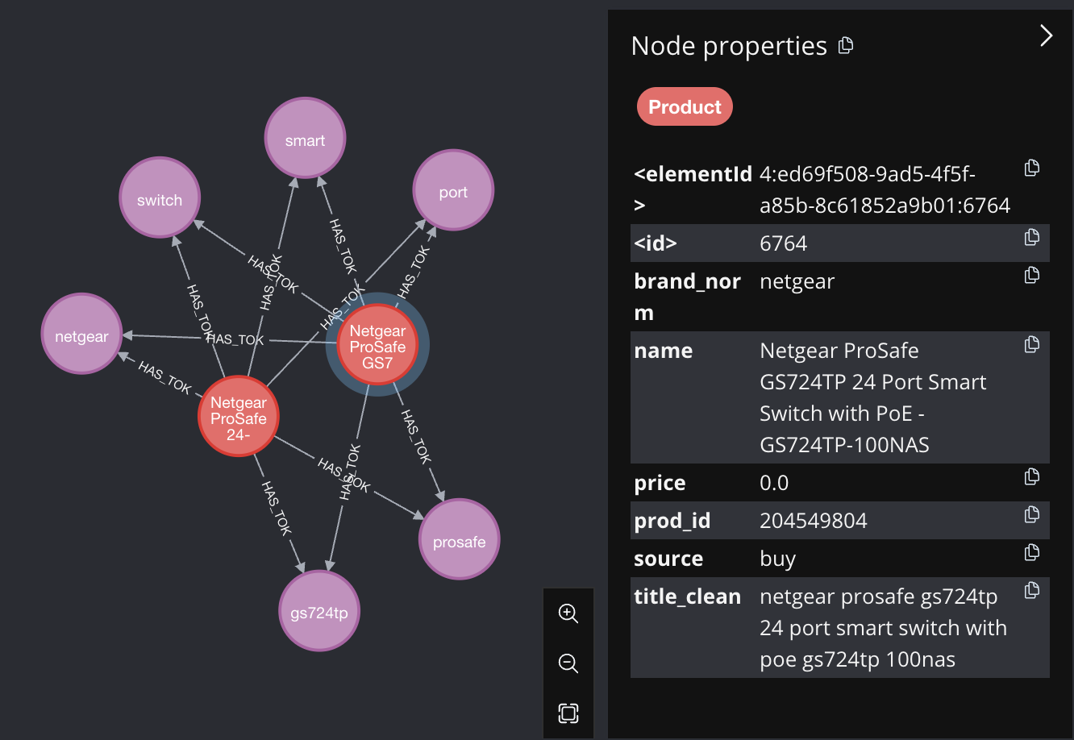
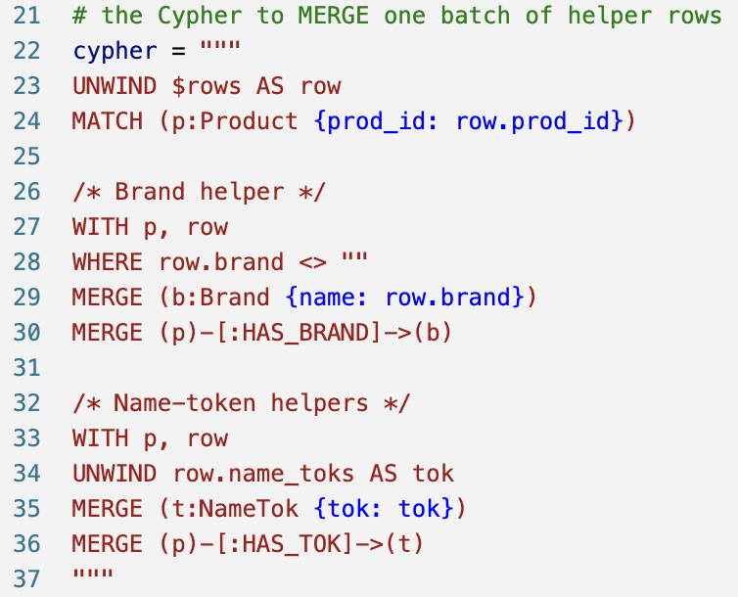
Code Explanation: Helper Rows and Tokenization
Notes:
In this step we take each product’s cleaned title and split it into meaningful tokens (e.g. ‘netgear’, ‘prosafe’, ‘smart’).
Then, in Neo4j we create two kinds of helper nodes—Brand and NameTok—and link each Product to its brand (HAS_BRAND) and to each token (HAS_TOK). This means any two products sharing a brand or a name‐token are now connected through the graph, which we’ll later use to generate candidate pairs for matching

Slide 23
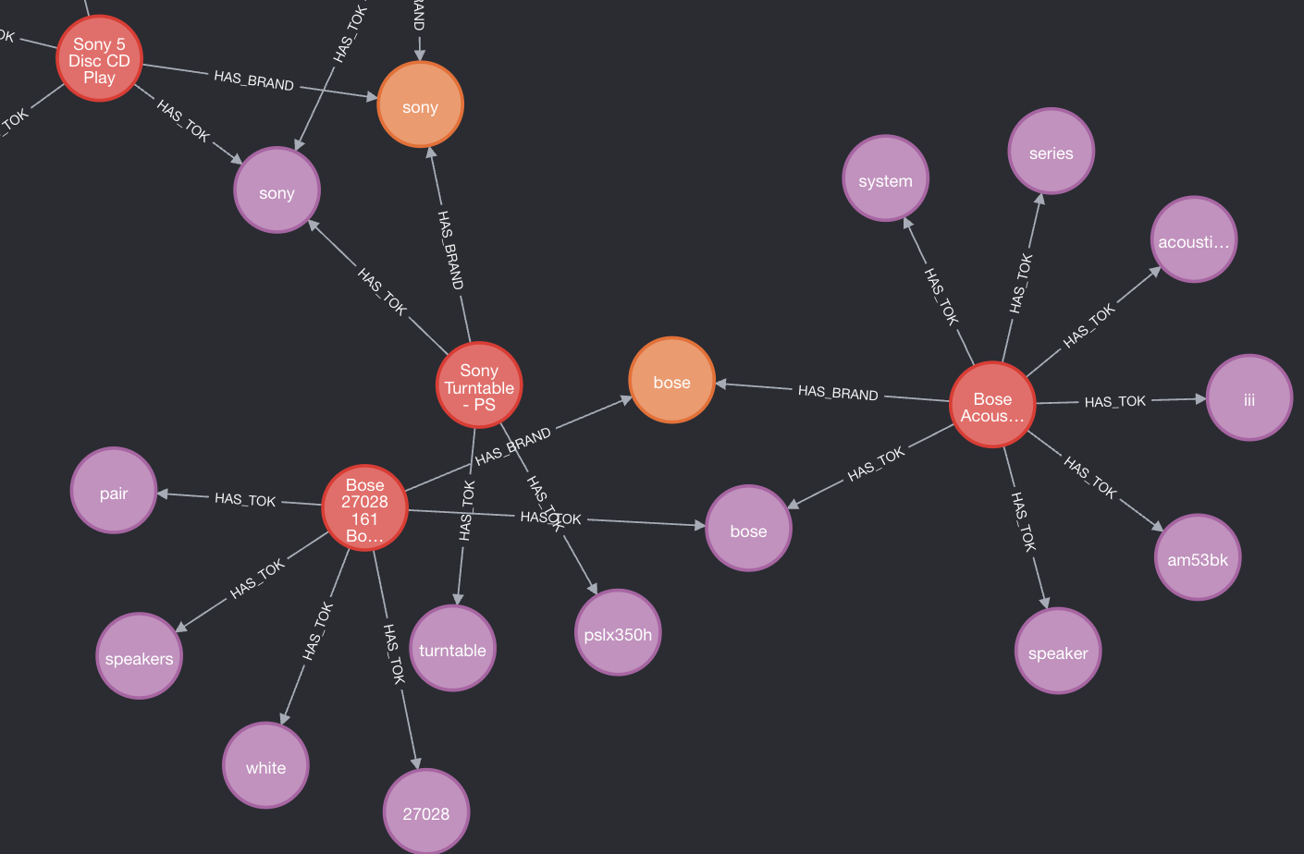
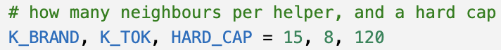
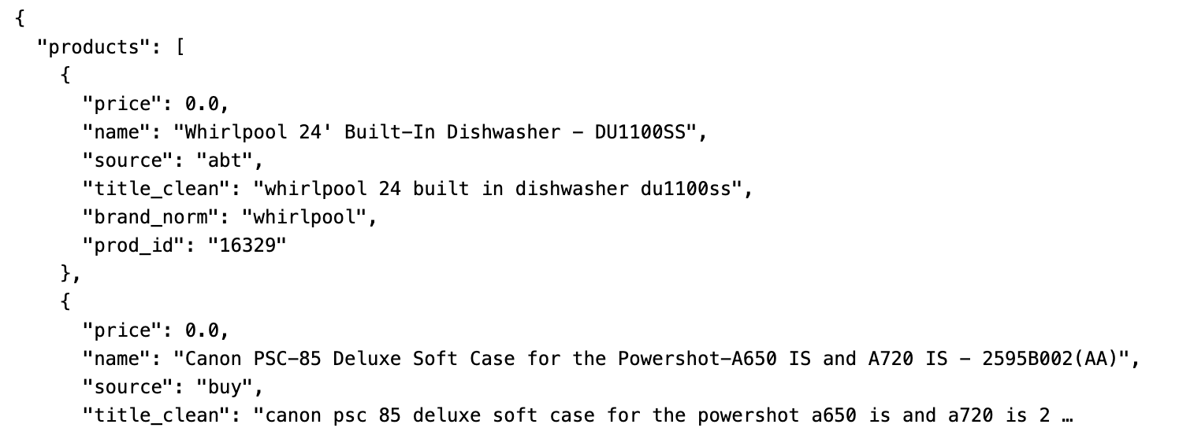
Code Explanation: Graph Retrieval Function
Notes:
This step is grabbing those two product nodes and its connections (brand and tokens). Based on that, we pull some of their neighbors with a ranking criteria; pulling those who have similar price for specific brands and tokenized titles. We fetch this subgraph and make it a json which then gets fed to our agents.
The first code snippet tells us how many neighbors we want to pull for each category so in this case it telling it to pull 15 neighbors of the same brand as well 8 neighbors that share the same token.
The second part is what our agent will receive, our node information has been formatted into a json which is readable for our agent.

Slide 24
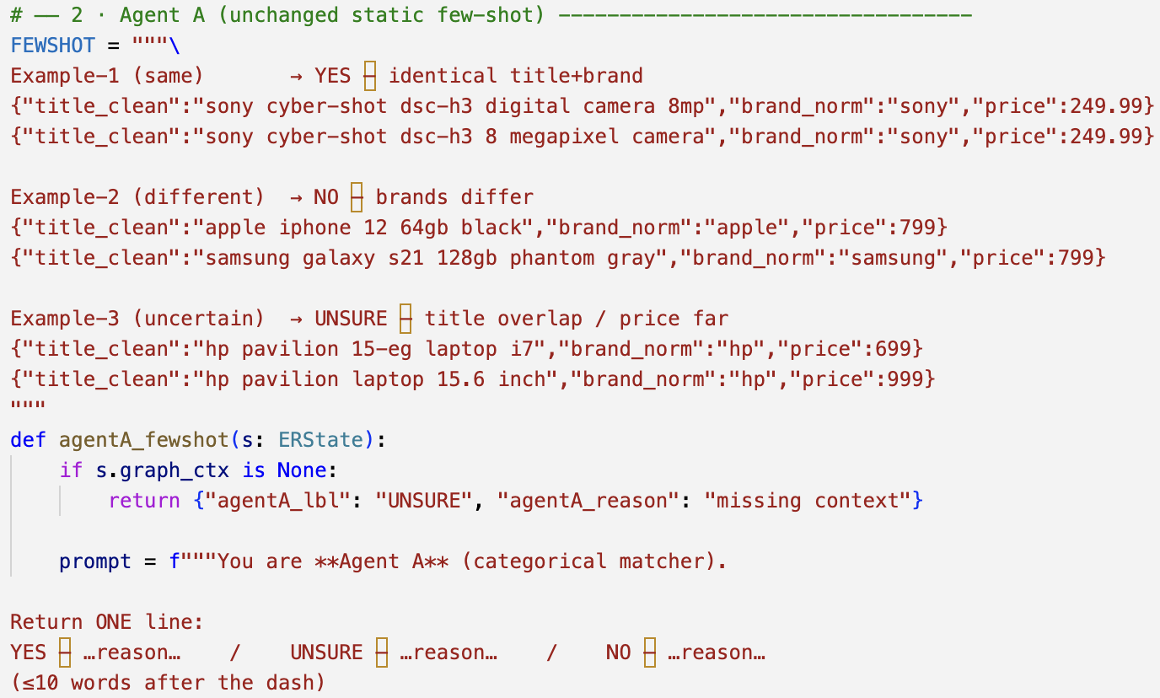
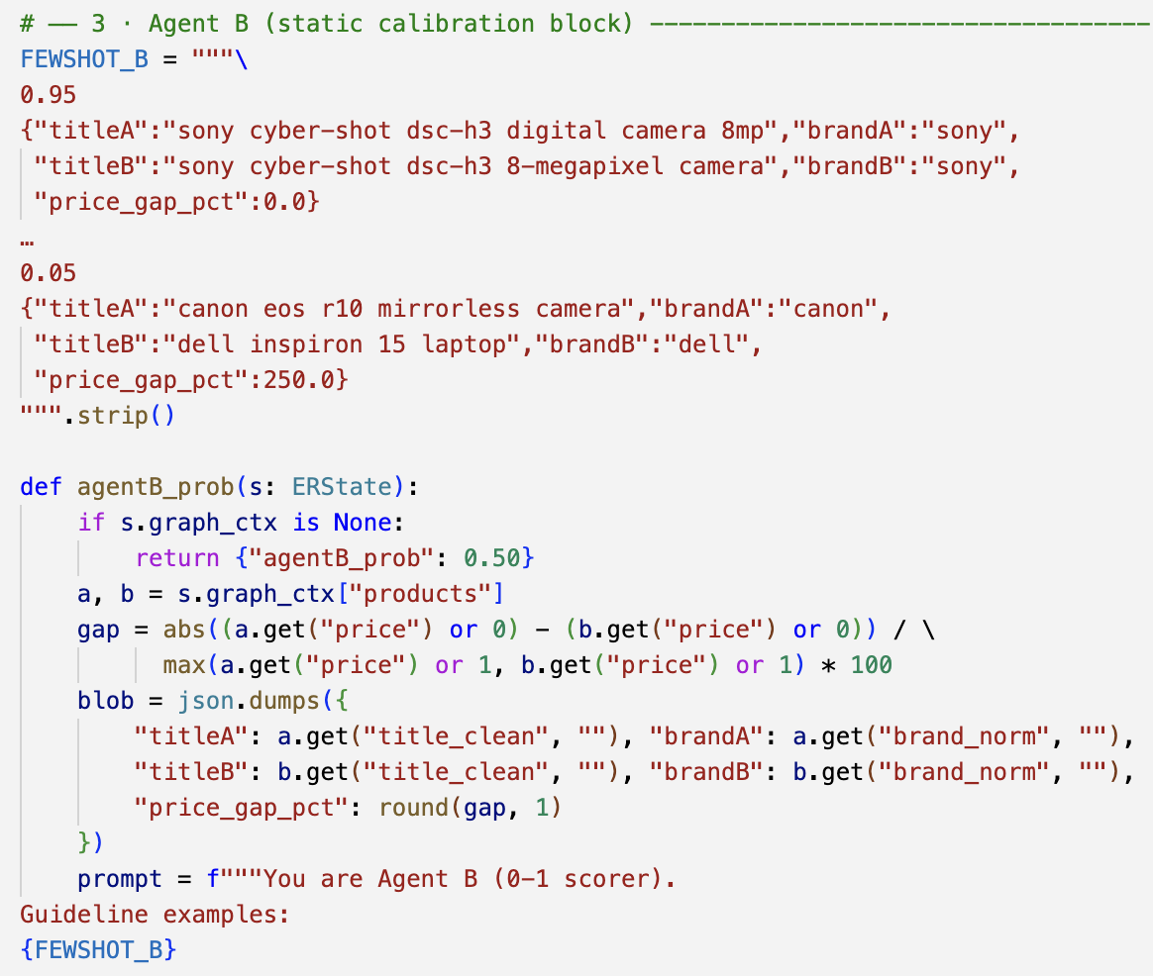
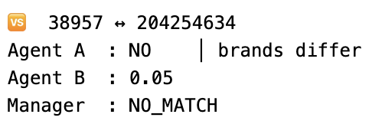
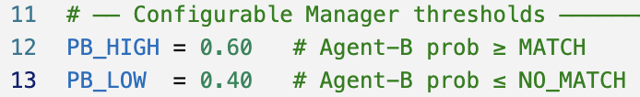
Code Explanation: Agent / Manager
Notes:
This is the brains of our pipeline as it’s in this step in which we give examples to our agents of how to correctly classify and consider if the two products that is seeing are indeed matches or not.
We have Agent A being a categorical classifier that gives us the following outputs: yes, unsure, and no along with a small reason to why its classifying the way it is.
Agent B is our probabilistic agent that similarly to our Agent A is looks at the titles and brands of both products but also looks at their prices and their disparity. It assigns a probability from 0 to 1.
Our manager is initiated with the following probabilities.

Slide 25
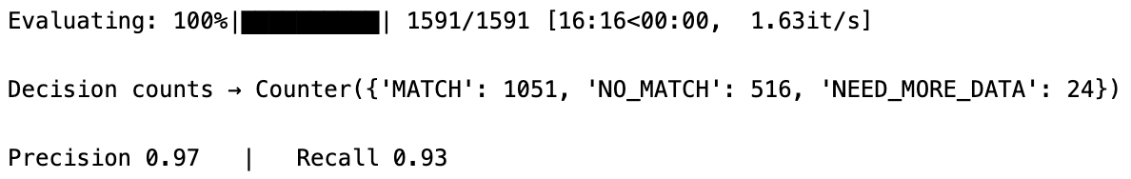
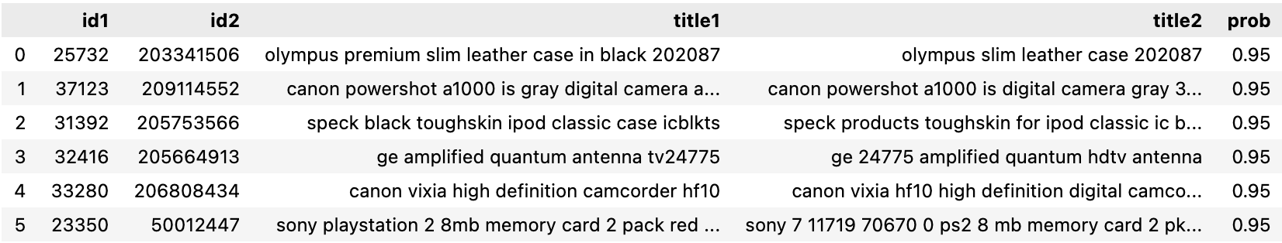
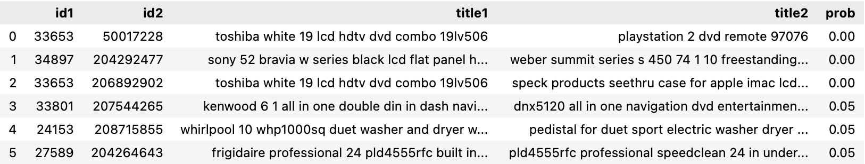
Code Explanation: Batch Evaluation / Precision & Recall
Notes:
This are the results of passing our data for the first time through our pipeline.
Remember precision is telling us: Of my MATCH predictions, how many were right?
And recall tells us: Of all the real matches, how many did I find?
These are just to showcase some of the records and its decisions.

Slide 26
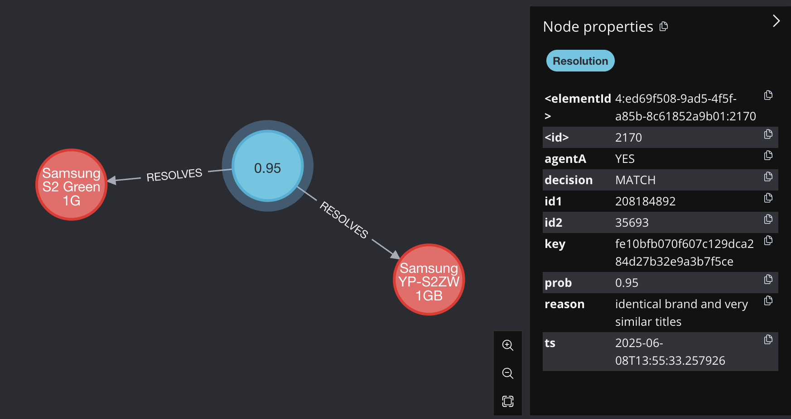
Code Explanation: Look at Graph

Slide 27
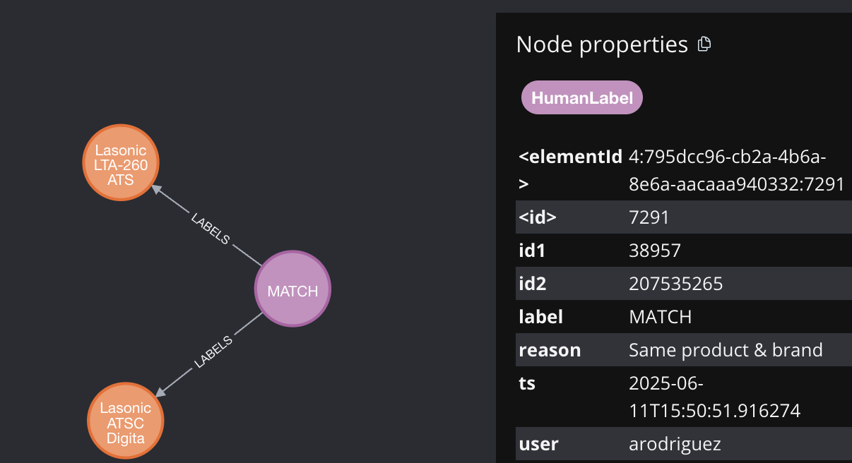
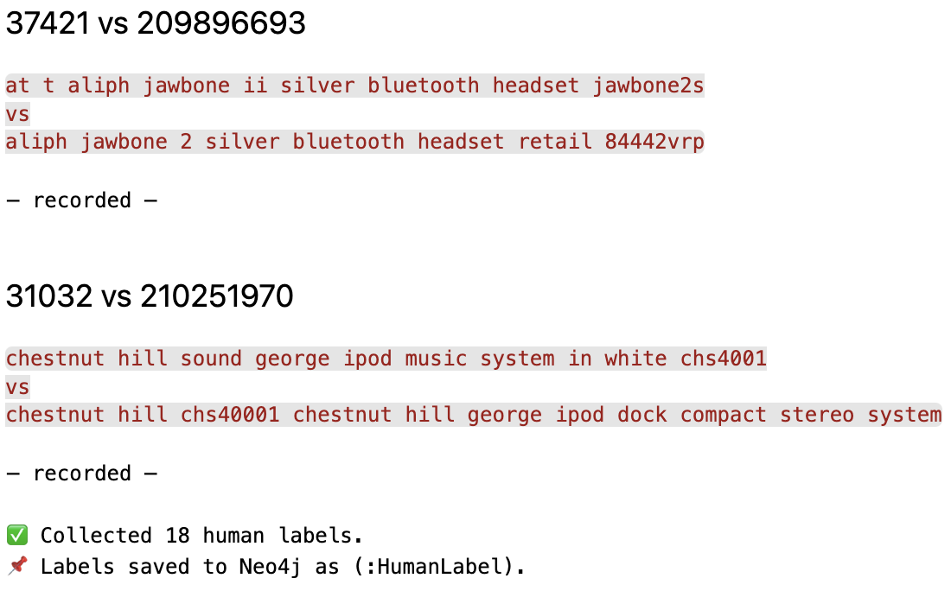
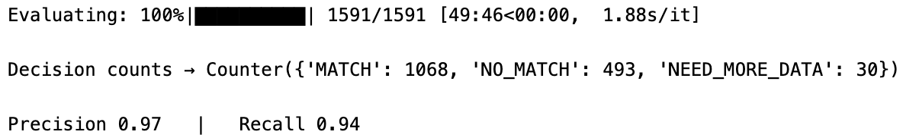
Code Explanation: Human Feedback
Notes:
So this is where we come in. The unsure cases classified by our agents would get fed to a human so that they can classify it manually, saying if it’s a match and why.

Slide 28
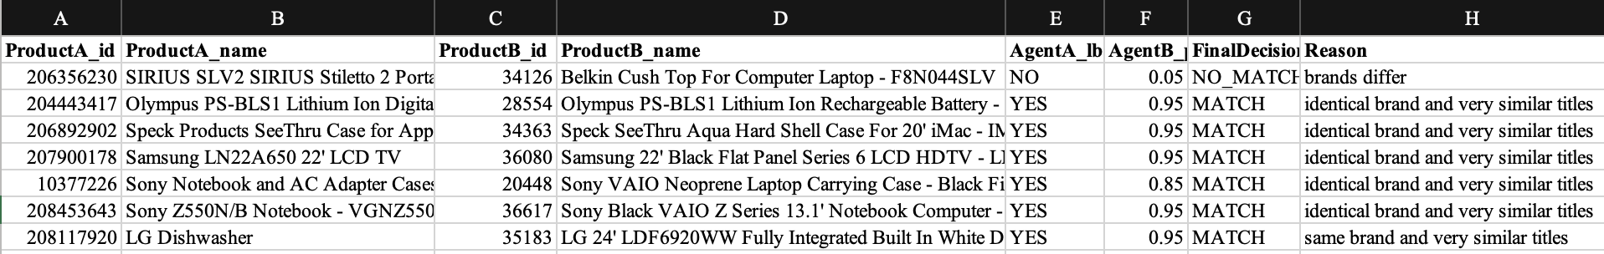
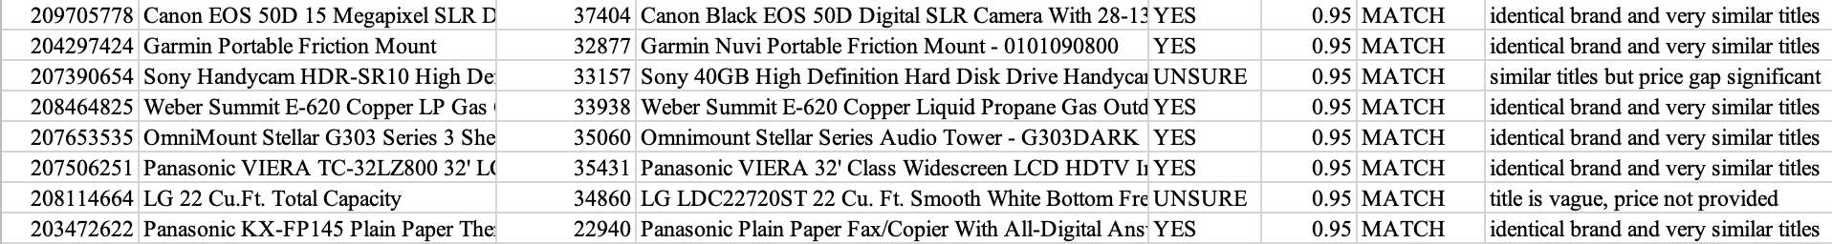
Code Explanation: Exporting Decisions

Slide 29
Sources
Rout, S. (2024). LangGraph for Beginners, Part 3: Conditional Edges. Medium.
Hunger, M. (2024). What Is GraphRAG? Neo4j Blog.
LangChain Team. (2024). LangGraph: Multi-Agent Workflows. LangChain Blog.
Liu, H., Wang, Z., Chen, X., Li, Z., Xiong, F., Yu, Q., & Zhang, W. (2025). HopRAG: Multi-Hop Reasoning for Logic-Aware RAG. arXiv:2502.12442.
Lee, J., Stevens, N., & Han, S. C. (2025). Large Language Models in Finance (FinLLMs). Springer Nature.
Wang, S., Yuan, H., Ni, L. M., & Guo, J. (2024). QuantAgent: Seeking Holy Grail in Trading by Self-Improving LLM. (preprint).
Wang, S., Yuan, H., Ni, L. M., & Guo, J. (2024). QuantAgent: Seeking Holy Grail in Trading by Self-Improving LLM. (preprint).
Kapoor, S., Stroebl, B., Siegel, Z. S., Nadgir, N., & Narayanan, A. (2024). AI Agents That Matter. (preprint).
Jiang, L. (2024). Detecting Scams Using Large Language Models. (preprint).

Slide 30
Thank you for attending!
Alejandro Rodriguez
Department of Finance
University of Central Florida
https://github.com/arodriguezb52
Notes:
I want to leave you with this thought:
If you can turn problems into paths, then you can turn your paths into agents.

